Slide 1
The Medium Access Control Sublayer
Chapter 4

Slide 2
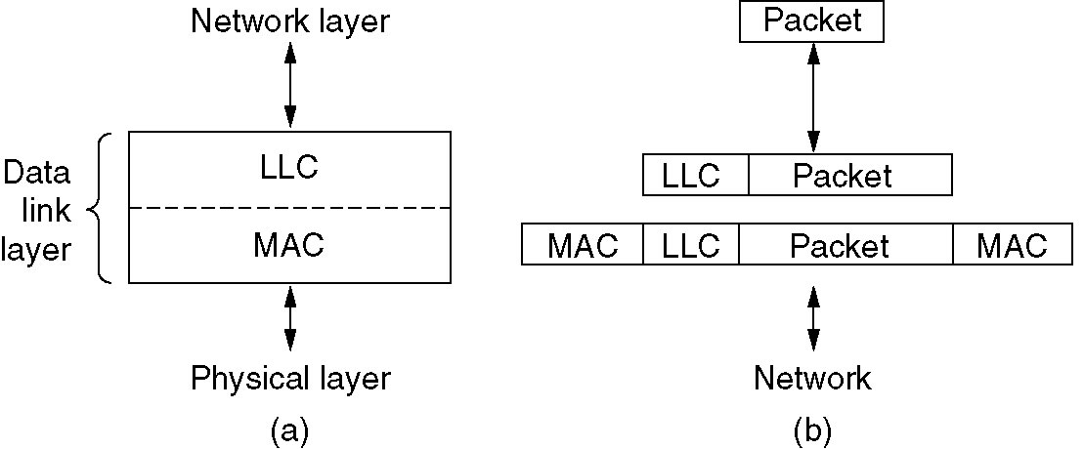
MAC子层负责介质访问控制机制的实现，即处理局域网中各站点对共享通信介质的争用问题，不同类型的局域网通常使用不同的介质访问控制协议，另外MAC子层还涉及局域网中的物理寻址；而LLC子层负责屏蔽掉MAC子层的不同实现，将其变成统一的LLC界面，从而向网络层提供一致的服务，LLC子层向网络层提供的服务通过与网络层之间的逻辑接口实现，这些逻辑接口又被称为服务访问点（SAP，Service Access Point）。这样的局域网体系结构不仅使得IEEE 802标准更具有可扩充性，有利于其将来接纳新的介质访问控制方法和新的局域网技术，同时也不会使局域网技术的发展或变革影响到网络层。

Slide 3
应 用 层
表 示 层
会 话 层
服务访问点
传 输 层
网 络 层
逻辑链路控制子层
数据链路层
媒体访问控制子层
物 理 层
物理层

Slide 4
The Channel Allocation Problem(1)
Static Channel Allocation in LANs and MANs
Dynamic Channel Allocation in LANs and MANs

Slide 5
The Channel Allocation Problem(2)
通常，可将信道分配方法划分为两类：静态分配方法和动态分配方法。
1．静态分配方法
所谓静态分配方法，也是传统的分配方法，它采用频分多路复用、时分多路复用或CDMA将单个信道划分后静态地分配给多个用户。
当用户站数较多或使用信道的站数在不断变化或者通信量的变化具有突发性时，静态频分多路复用方法的性能较差，因此，传统的静态分配方法，不完全适合计算机网络。

Slide 6
The Channel Allocation Problem(3)
2．动态分配方法
所谓动态分配方法就是动态地为每个用户站点分配信道使用权。
① 竞争法协议
② 无冲突法协议
③ 有限竞争协议

Slide 7
Dynamic Channel Allocation in LANs and MANs
Station Model.（站模式）
Single Channel Assumption.（单信道假设）
Collision Assumption.（冲突假设）
(a) Continuous Time.（连续时间） (b) Slotted Time.（时隙时间）
(a) Carrier Sense.（载波侦听） (b) No Carrier Sense.

Slide 8
Multiple Access Protocols
ALOHA
Carrier Sense Multiple Access Protocols（载波侦听多路访问协议 CSMA）
Collision-Free Protocols（无冲突协议）
Limited-Contention Protocols（有限竞争协议）
Wireless LAN Protocols

Slide 9
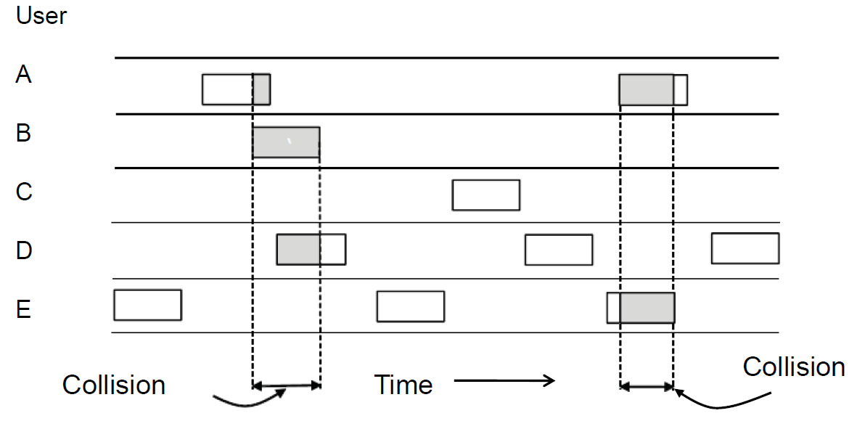
Pure ALOHA（1）
In pure ALOHA
Frames are transmitted at completely arbitrary times.
Listen when sending to detect collision
If collision, delay a random time and retransmit.

Slide 10
Pure ALOHA（2）
基本思想
只要一个站点想要传输信息帧，它就把信息帧传输出去。
信息帧传输过程中，站点侦听检测冲突。
如果发生冲突，传输站点延长随机时间重发信息帧。如果在发了好几次后仍得不到确认，就只好放弃。

Slide 11
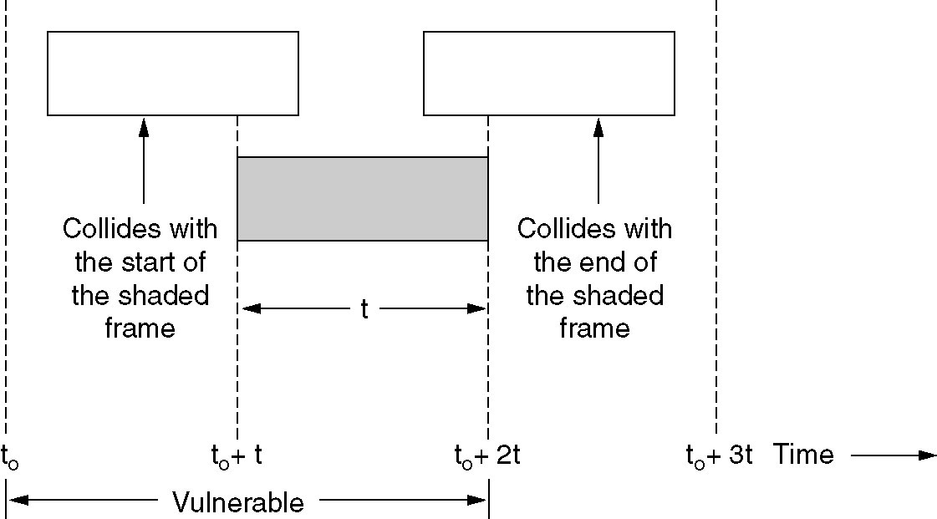
Pure ALOHA (3)
Vulnerable period for the shaded frame.

Slide 12
Pure ALOHA(4)
Efficiency of pure ALOHA
Frame time:the amount of time needed to transmit a standard frame.
S: throughput, the number of new frames generated per frame time, 0<S<1
G: the number of frames (new and old) waited for send per frame time S<=G
P₀: the probability that a frame does not suffer a collision
S=GP₀
The probability that k frames are generated during a given frame time according the Poisson distribution:
P_{r}[k] = G^{k}e^{-G}/k!
When k=0 (no other frame to send), P₀=e^{-G}
In two frame time, the number of frames generated is 2G,
P₀=e^{-2G} ,S=Ge^{-2G}
When G = 0.5 , S=1/2e, a maximum throughput

Slide 13
Slotted ALOHA
Slotted ALOHA
Sending when the next slot begins
Vulnerable period only at one slot time
P₀=e^{-G} ,S=Ge^{-G}
When G = 1 , S=1/e, a maximum throughput
信道上的时间被分成离散的时间间隔即时槽，其大小相当于帧的传输时间。所有站点的时钟保持同步。站点只有在时槽开始时才能传输数据。
只有那些都在同一个时槽开始进行传输的帧才有可能冲突，可能发生冲突危险区比ALOHA降低了一半 。

Slide 14
ALOHA
Example:
Measurement of a slotted ALOHA channel with an infinite number of users show that 20 percent of slots are idle .
What is the channel load, G?
What is the throughput?
Is the channel underloaded or overloaded?
1) Poisson distribution: Pr[k] = G^{k}e^{-G}/k!
P₀=e^{-G} ，so G= -lnP₀ = -ln 0.2 = 1.6
2) S = G*e^{-G} = G*0.2 = 1.6*0.2 = 0.32
3) G = 1.6 >1, so the channel is overloaded.

Slide 15
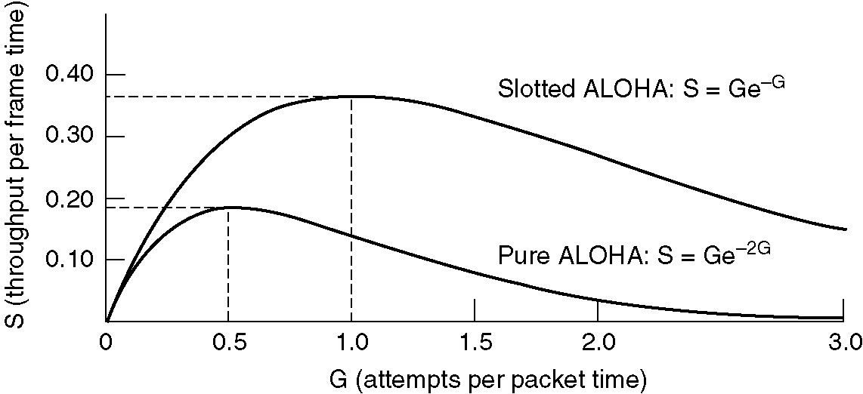
ALOHA
Throughput versus offered traffic for ALOHA systems.

Slide 16
CSMA（载波监听多路访问）
ALOHA 和分槽ALOHA都没有利用到无线分组网和局域网的一个主要特性，那就是与帧的传输时间相比，传播时间是很短的：当一个站点发送帧后，别的站点马上就会知道。
Persistent and Nonpersistent CSMA
1-persistent CSMA
Nonpersistent CSMA
P-persistent CSMA

Slide 17
CSMA机制：也称为先听先说
想要传输的站点首先侦听传输介质上是否有其他站点在传输（载波监听〕。如果传输介质忙，它必须等待。如果空闲，则可传输。
两个或多个站点还是有可能同时开始传输，这时就会产生冲突。考虑到这种情况，发送站点在发送完后要等待一段时间（要把来回传输的最大时间和发送确认的站点竞争信道的时间考虑在内）以等待确认，如果没有收到确认，发送站点认为发生了冲突，就重发该帧。

Slide 18
CSMA：持续算法
当发现传输介质忙时，站点该怎么办？
非持续CSMA
基本思想：
若媒体空闲就传输；否则，转到第2步
若媒体忙，等待一段随机的重传延迟时间，重复第1步
缺点：如果多个站点同时会浪费部分信道容量

Slide 19
CSMA：持续算法（续）
1-持续CSMA协议
基本思想：
若媒体空闲就传输；否则，转到第2步。
若媒体忙则继续监听，直到检测到信道空闲然后立即传输。
如有冲突，则等待一段随机的时间重复第1步。

Slide 20
P-持续协议：
若媒体空闲，以概率P传输，以概率(1-P)延迟一个时间单位。该时间单位通常等于最大的传播延迟的两倍。
若传输延迟了一个时间单位，则重复第1步。
若媒体忙，继续监听直到信道空闲并重复第1步。

Slide 21
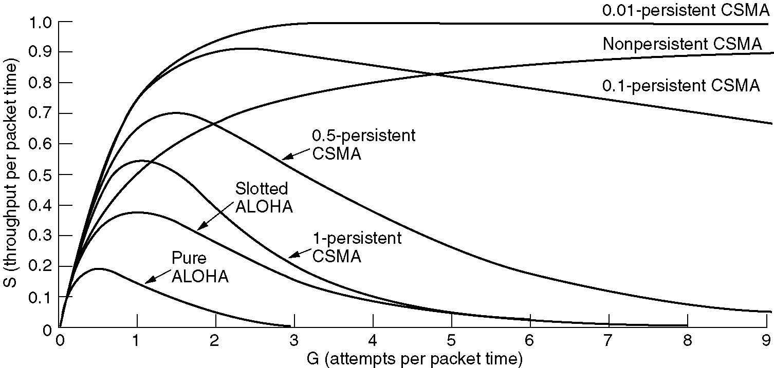
Persistent（持续） and Nonpersistent（非持续） CSMA(1)
Comparison of the channel utilization versus load for various random access protocols.

Slide 22
Persistent（持续） and Nonpersistent（非持续） CSMA(2)
1-persistent CSMA (Carrier Sense Multiple Access)
Frames are transmitted when station detect an idle channel.
If channel is busy, station waits until it becomes idle.
Nonpersistent CSMA
Frames are transmitted when station detect an idle channel.
If channel is busy, station waits a random period of time and then senses the channel again until it becomes idle.
P- persistent CSMA
when station detect an idle channel, Frames are transmitted with a probability p. With a probability q=1-p, it defers until the next slot.
If channel is busy, station waits until the next slot and applies the above algorithm.

Slide 23
以太网：CSMA/CD
载波监听多路访问/冲突检测CSMA/CD
载波监听：站点能监测到链路是忙还是空闲；
冲突检测：站点在传输的同时监听信道，从而能够监测到站点所传输的帧与别的站点传输的帧之间发生冲突的情形 。

Slide 24
CSMA/CD（续）
基本算法：
若媒体空闲，传输；否则，转第2步。
若媒体忙，一直监听直到信道空闲然后立即传输。
若在传输中监听到冲突，发出一个短小的人为干扰信号让所有的站点都知道发生了冲突并停止传输。
发完人为干扰信号，等待一段随机的时间，再次试图传输（从第1步开始重复〕。

Slide 25
CSMA/CD（续）
CSMA/CD协议的工作过程通常可以概括为：
先听后发、
边听边发、
冲突停发、
随机重发。
信道忙
信道闲
Y
N
N
Y

Slide 26
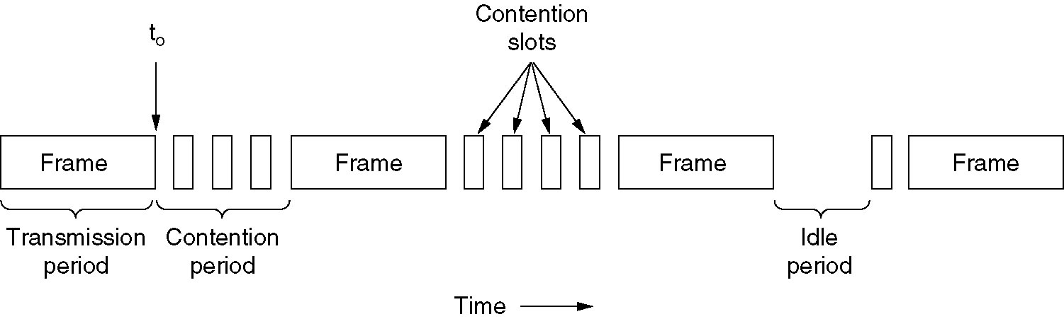
CSMA with Collision Detection （带冲突检测的载波侦听多路访问）
CSMA/CD can be in one of three states: contention, transmission, or idle.

Slide 27
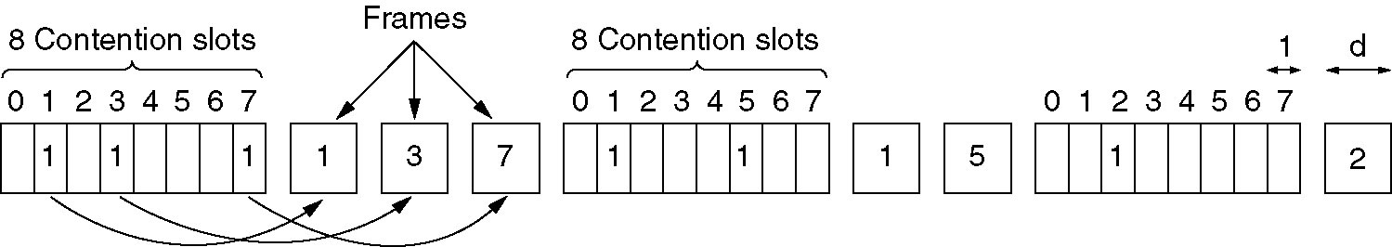
Collision-Free Protocols
Collision-free protocols avoid collisions entirely
Senders must know when it is their turn to send
The basic bit-map protocol:
Sender set a bit in contention slot if they have data
Senders send in turn; everyone knows who has data
The basic bit-map protocol.

Slide 28
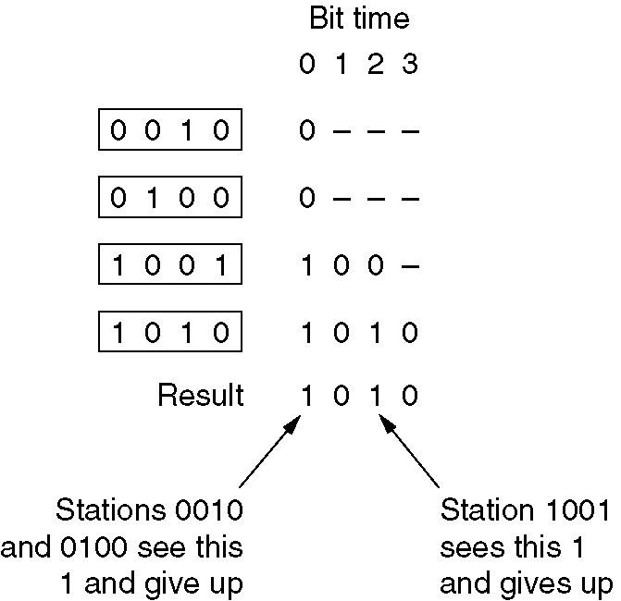
Collision-Free Protocols (2)
Binary countdown improves on the bitmap protocol
The binary countdown protocol. A dash indicates silence.
Stations send their address in contention slot (log₂ N bits instead of N bits)
Medium ORs bits; stations give up when they send a “0” but see a “1”
Station that sees its full address is next to send

Slide 29
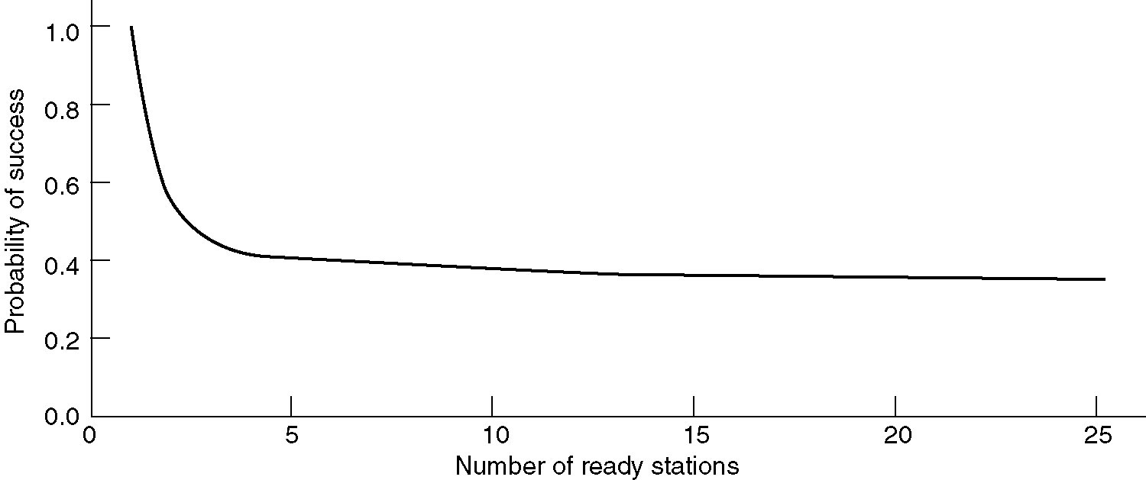
Limited-Contention Protocols
Idea is to divide stations into groups within which only a very small number are likely to want to send
Avoids wastage due to idle periods and collisions
Already too many contenders for a good chance of one winner
Acquisition probability for a symmetric contention channel.

Slide 30
Wireless LAN Protocols (1)
Wireless has complications compared to wired.
Nodes may have different coverage regions
Leads to hidden and exposed terminals
Nodes can’t detect collisions, i.e., sense while sending
Makes collisions expensive and to be avoided

Slide 31
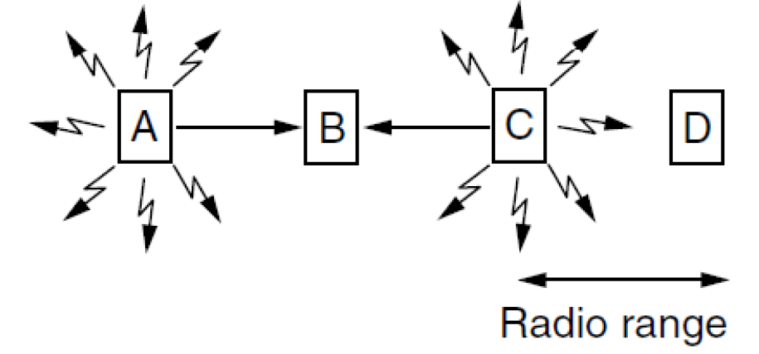
Wireless LANs (2) – Hidden terminals
Hidden terminals are senders that cannot sense each other but nonetheless collide at intended receiver
• Want to prevent; loss of efficiency
• A and C are hidden terminals when sending to B

Slide 32
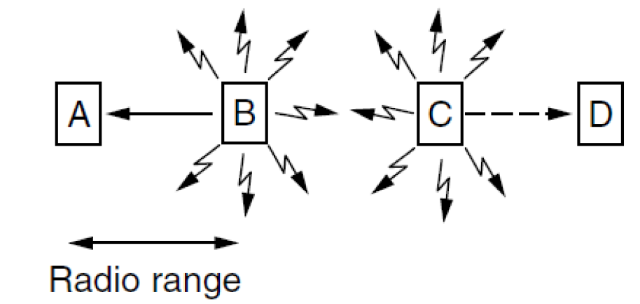
Wireless LANs (3) – Exposed terminals
Exposed terminals are senders who can sense each other but still transmit safely (to different receivers)
• Desirably concurrency; improves performance
• B —>A and C —> D are exposed terminals

Slide 33
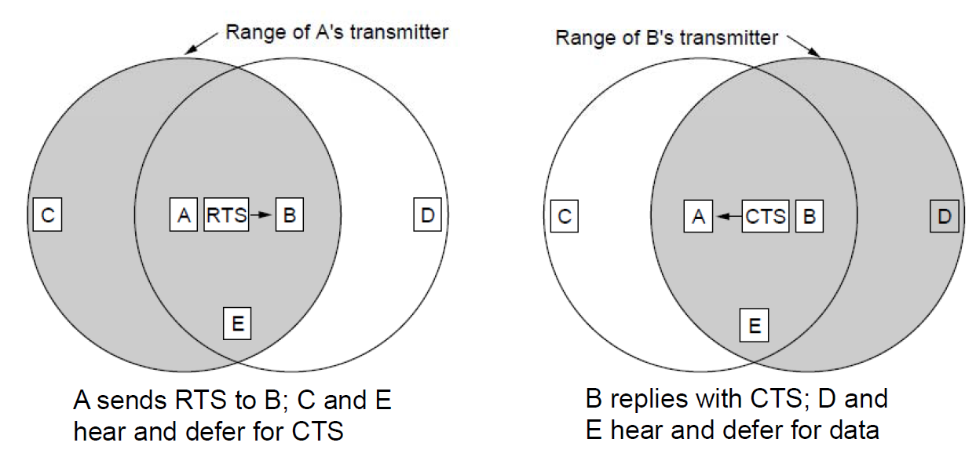
Wireless LANs (4) – MACA
MACA(Multiple Access with Collision Avoidance) protocol grants access for A to send to B:
A sends RTS to B [left]; B replies with CTS [right]
A can send with exposed but no hidden terminals

Slide 34
Ethernet
Ethernet Cabling
Manchester Encoding
The Ethernet MAC Sublayer Protocol
The Binary Exponential Backoff Algorithm（二进制指数后退算法）
Ethernet Performance
Switched Ethernet
Fast Ethernet
Gigabit Ethernet
IEEE 802.2: Logical Link Control
Retrospective on Ethernet

Slide 35
以太网的产生和发展
以太网的起源:ALOHA无线电系统(1968-1972)
Xerox 创建第一个实验性的以太网(1972-1977)
DEC、Intel和Xerox将以太网标准化(1979-1983)
IEEE 802.3标准问世（1982年）,10BASE-5出现；
10BASE-T结构化布线的历史(1986-1990)
交换式和全双工制以太网的出现(1990-1994)
快速以太网的出现(1992-1995)
千兆网的出现(1996至今)

Slide 36
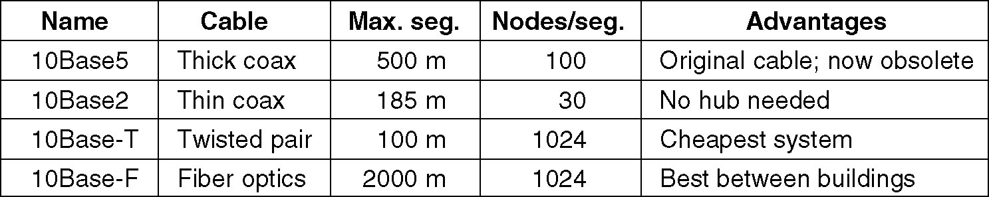
Ethernet Cabling
有4种正式的10 Mbps以太网标准。
① 10Base-5：10Base-5是最初的粗同轴电缆以太网标准。
② 10Base-2：10Base-2是细同轴电缆以太网标准。
③ 10Base-T：10Base-T是10 Mbps的双绞线以太网标准。
④ 10Base-F：10Base-F是10 Mbps的光缆以太网标准。
The most common kinds of Ethernet cabling.

Slide 37
10 Base-5
数据率（Mbps）
基带信号
段最大长度（百米）

Slide 38
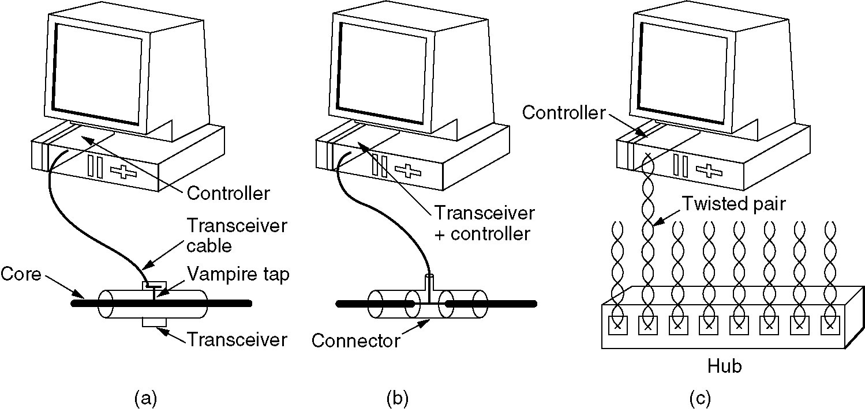
Ethernet Cabling (2)
Three kinds of Ethernet cabling.
(a) 10Base5, (b) 10Base2, (c) 10Base-T.

Slide 39
最大长度
100m
NIC

Slide 40
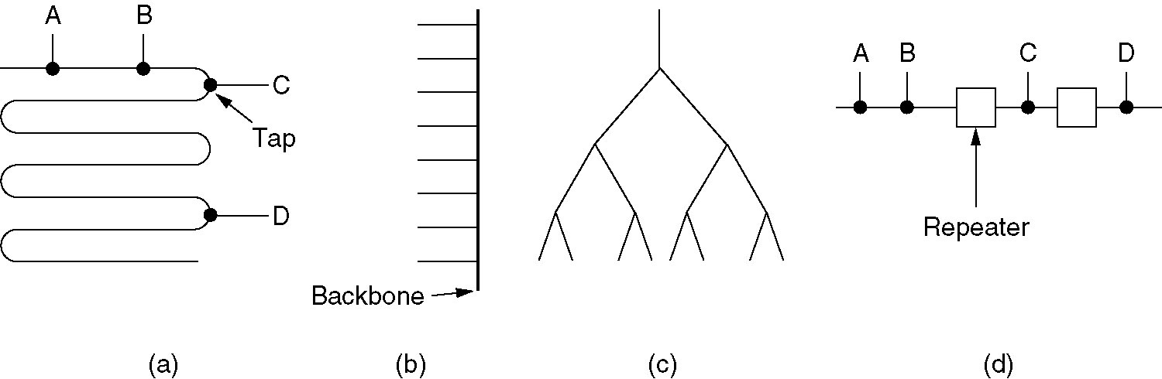
Ethernet Cabling (3)
Cable topologies. (a) Linear, (b) Spine, (c) Tree, (d) Segmented.

Slide 41
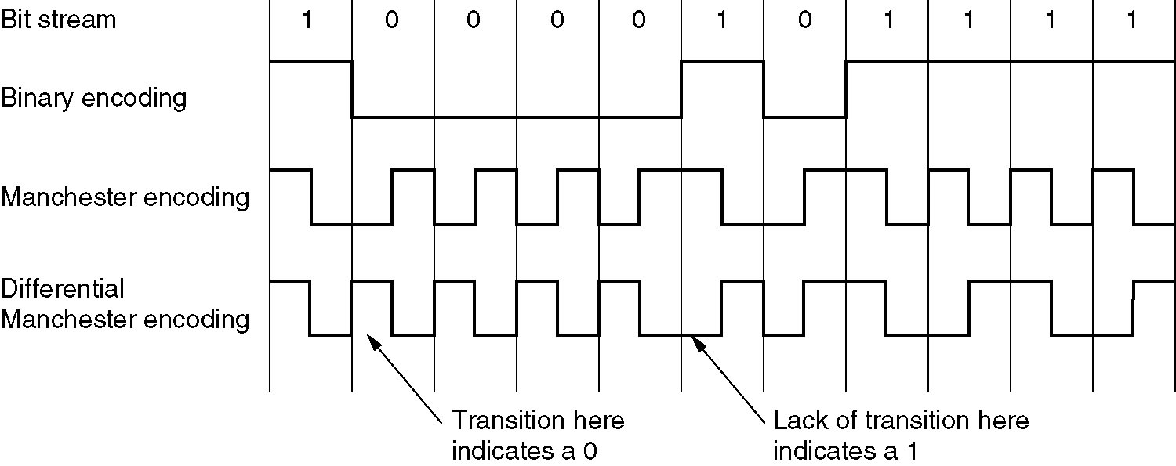
Ethernet Cabling (4)
(a) Binary encoding, (b) Manchester encoding, (c) Differential Manchester encoding.

Slide 42
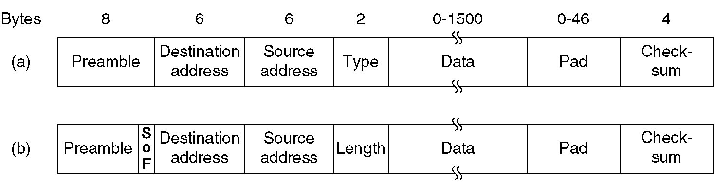
Ethernet MAC Sublayer Protocol
Frame formats. (a) DIX Ethernet, (b) IEEE 802.3.

Slide 43
Ethernet MAC Sublayer Protocol
Preamble, 8 bytes, each containing the bit pattern 10101010 to synchronize .
SOF, 10101011
Type, specifies which process to give the frame to.
Length of data
Maximal length
Minimal length (2τ)
To distinguish valid frames from garbage,
Pad, to fill out the frame to the minimum size
Any number there less than or equal to 1500 can be interpreted as Length, and any number greater than 1500 can be interpreted as Type.

Slide 44
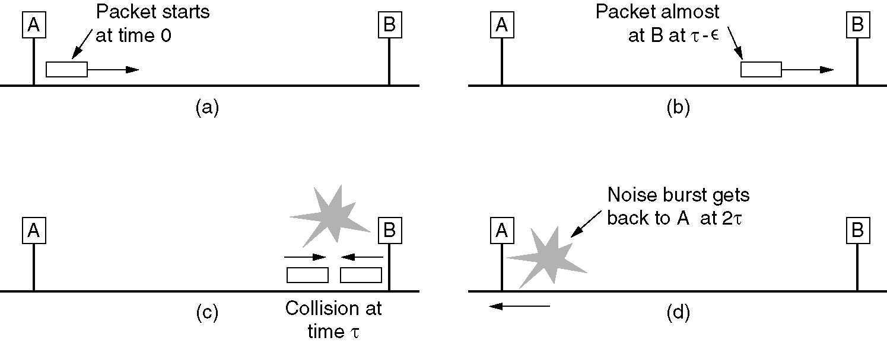
Ethernet MAC Sublayer Protocol (2)

Slide 45
The Binary Exponential Backoff Algorithm
When a collision occurs, waits a random time before trying again
Time is divided into discrete slots, 2τ.
to dynamically adapt to the number of stations trying to send.
after i collisions, a random number between 0 and 2^{i} - 1 is chosen , and that number of slots is skipped before trying again.

Slide 46
CSMA/CD采用1持续方式，遇到冲突后采用二进制指数退避技术：
时间被分成离散的时槽，其长度等于在传输媒体上来回传输的时间，802.3标准规定为512比特时间。
第一次冲突产生后，每个站点等待0或1个时槽后尝试重新发送。
i次冲突后，等待的时槽数从0～2^{i}-1中随机选出
如果冲突的次数达到10次后，随机等待的最大时槽数固定为1023。在16次冲突后，站点放弃传输，并报告一个错误。

Slide 47
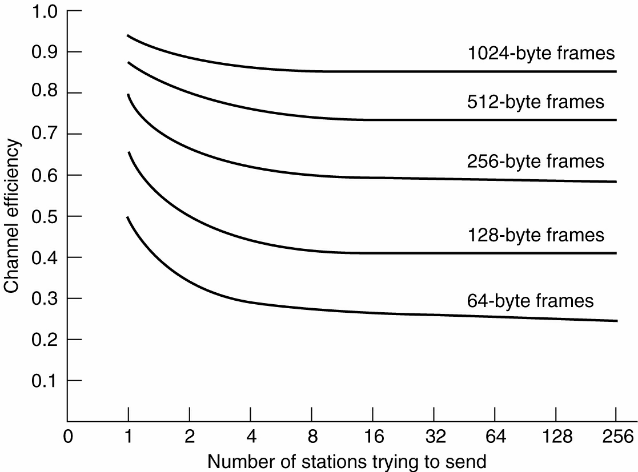
Ethernet Performance
Efficiency of Ethernet at 10 Mbps with 512-bit slot times.

Slide 48
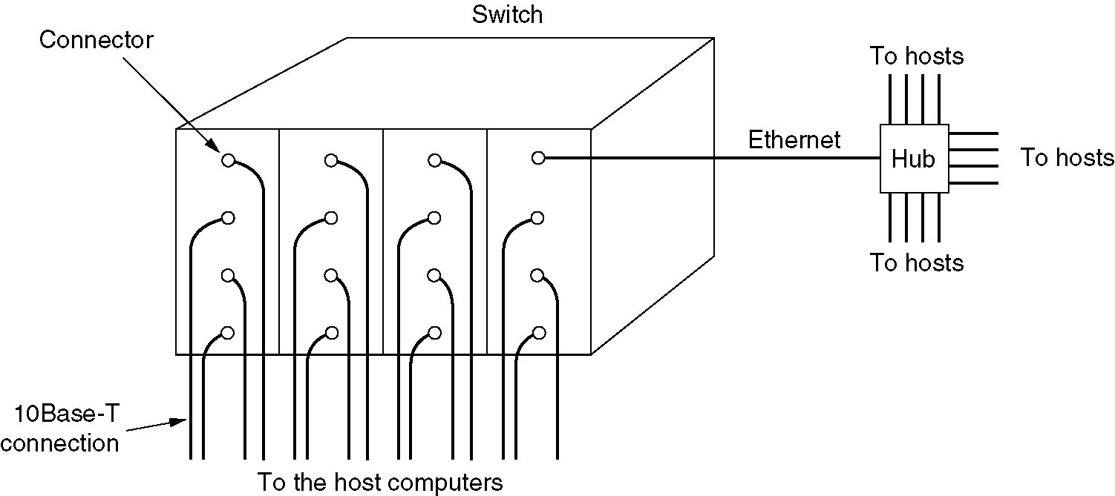
Switched Ethernet
交换机以太网利用以太网交换机组网，既可以将计算机直连到交换机的端口上，也可以将它们连入一个网段，然后将这个网段连到交换机的端口。如果将计算机直接连到交换机的端口，那么它将独享该端口提供的带宽；如果计算机通过以太网连入交换机，那么该以太网上的所有计算机共享交换机端口提供的带宽。
A simple example of switched Ethernet.

Slide 49
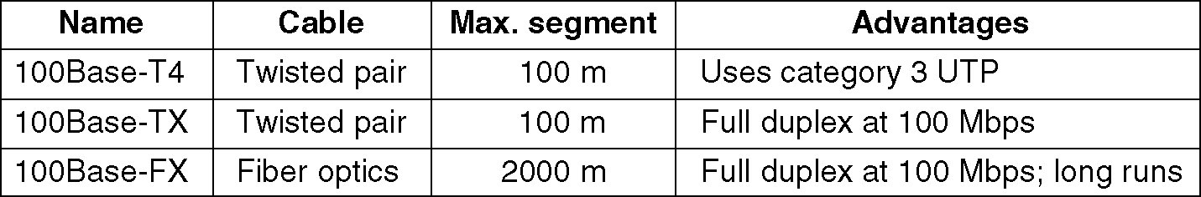
Fast Ethernet
快速以太网技术100Base-T是由10Base-T标准以太网发展而来的。其协议标准为1995年颁布的IEEE 802.3u，可支持100 Mbps的数据传输速率，并且与10Base-T一样可支持共享式与交换式两种使用环境，在交换式以太网环境中可以实现全双工通信。IEEE 802.3u在MAC子层仍采用CSMA/CD作为介质访问控制协议，并保留了IEEE 802.3的帧格式。
The original fast Ethernet cabling.

Slide 50
Fast Ethernet (Example)
采用快速以太网集线器作为中央设备（100Base-TX集线器），使用非屏蔽5类双绞线以星型连接的方式连接以太网节点（工作站和服务器），以及连接另一个快速以太网集线器和10Base-T的共享集线器。

Slide 51
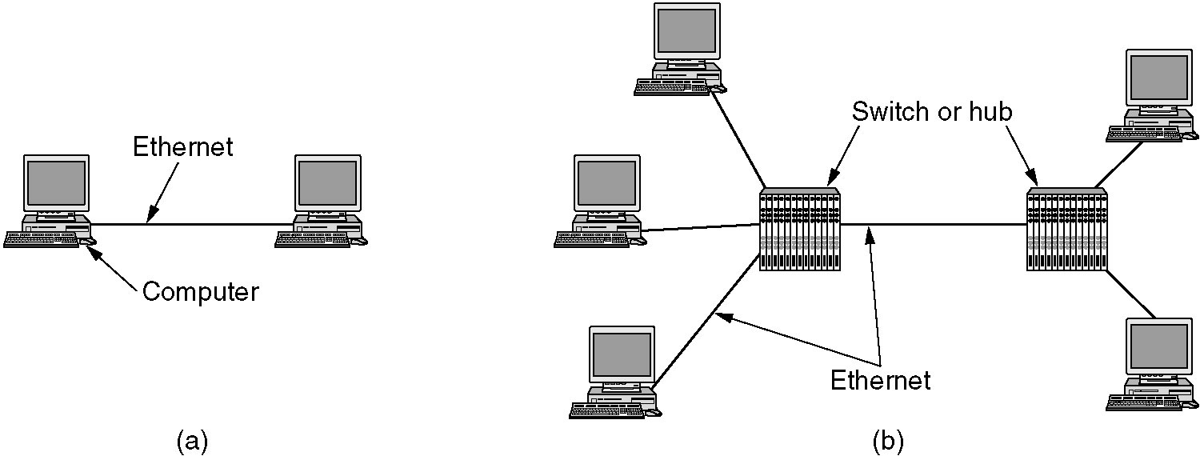
Gigabit Ethernet
(a) A two-station Ethernet. (b) A multistation Ethernet.

Slide 52
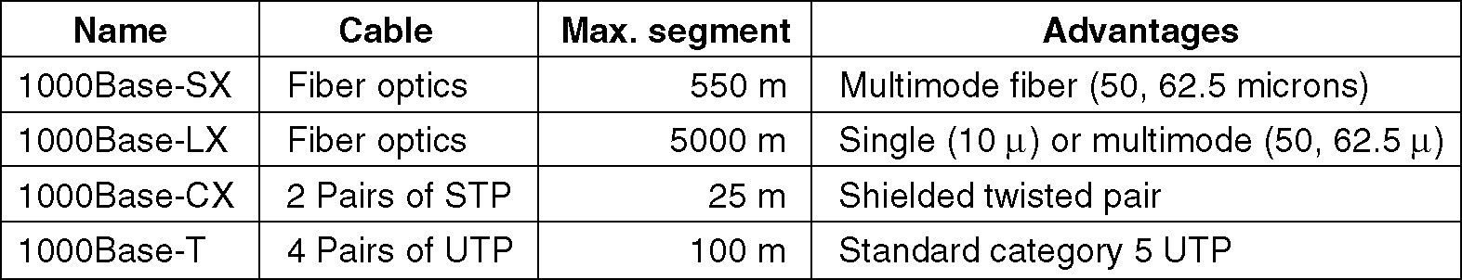
Gigabit Ethernet (2)
Gigabit Ethernet cabling.

Slide 53
Wireless LANs
802.11 architecture/protocol stack »
802.11 physical layer »
802.11 MAC »
802.11 frames »

Slide 54
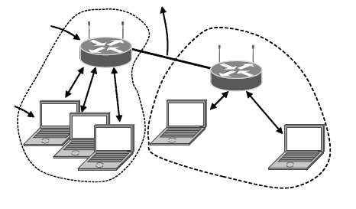
802.11 Architecture/Protocol Stack (1)
Wireless clients associate to a wired AP (Access Point)
Called infrastructure mode;
there is also ad hoc mode with no AP, but that is rare.
To Network
Access Point
Client

Slide 55
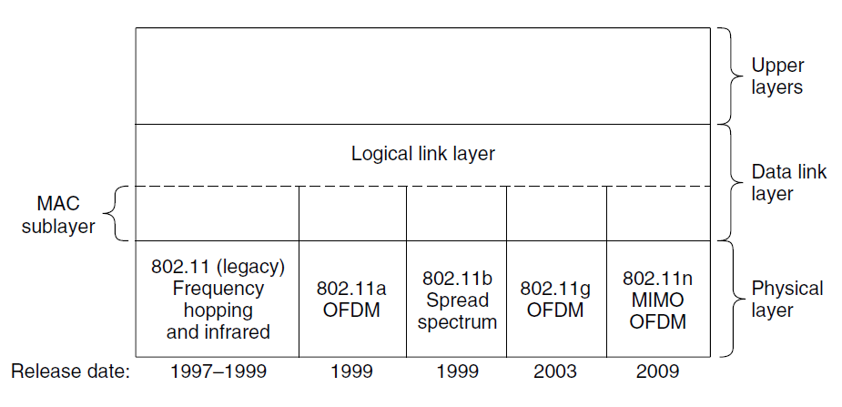
802.11 Architecture/Protocol Stack (2)
MAC is used across different physical layers
Name | Technique | Max. Bit Rate
802.11b | Spread spectrum, 2.4 GHz | 11 Mbps
802.11g | OFDM, 2.4 GHz | 54 Mbps
802.11a | OFDM, 5 GHz | 54 Mbps
802.11n | OFDM with MIMO, 2.4/5 GHz | 600 Mbps

Slide 56
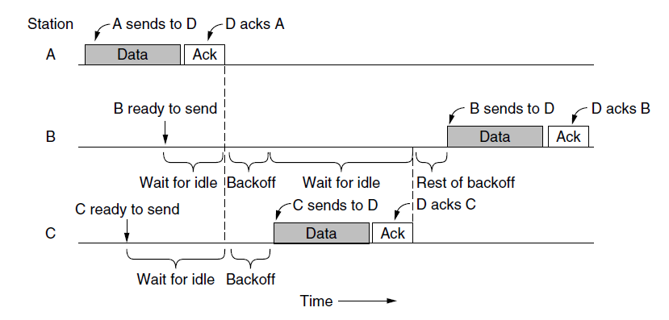
802.11 MAC (1)
CSMA/CA inserts backoff slots to avoid collisions
MAC uses ACKs/retransmissions for wireless errors

Slide 57
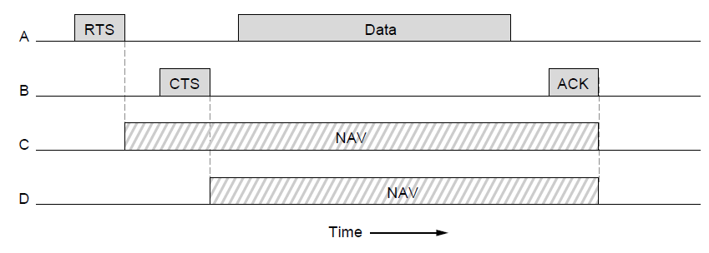
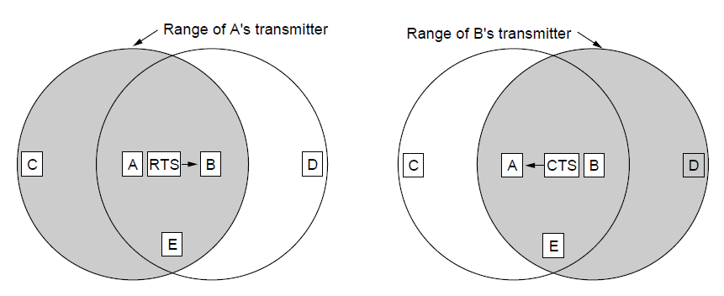
802.11 MAC (2)
Virtual channel sensing with the NAV（Network Allocation Vector） and optional RTS/CTS (often not used) avoids hidden terminals

Slide 58
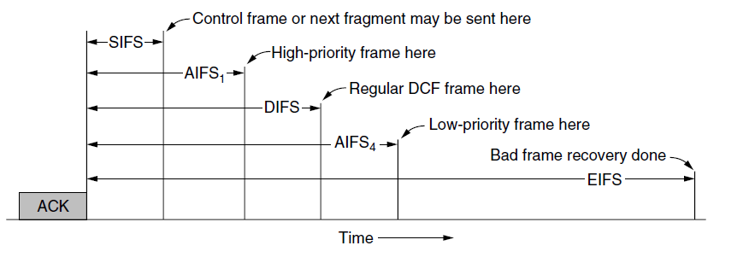
802.11 MAC (3)
Different backoff slot times add quality of service
Short intervals give preferred access, e.g., control, VoIP
MAC has other mechanisms too, e.g., power save
DIFS: DCF(Distributed Coordination Function) InterFrame Spacing
SIFS: Short InterFrame Spacing
AIFS: Arbitration InterFrame Spacing
EIFS: Extended InterFrame Spacing

Slide 59
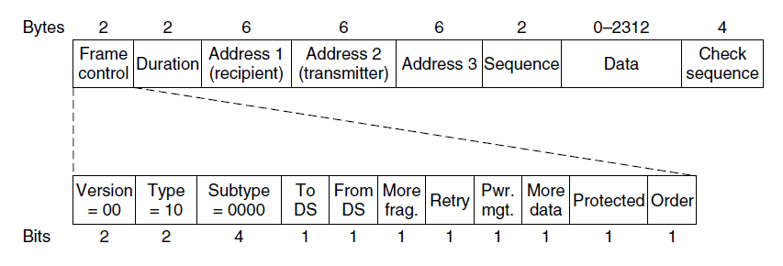
802.11 Frames（1）
Frames vary depending on their type (Frame control)
Data frames have 3 addresses to pass via APs

Slide 60
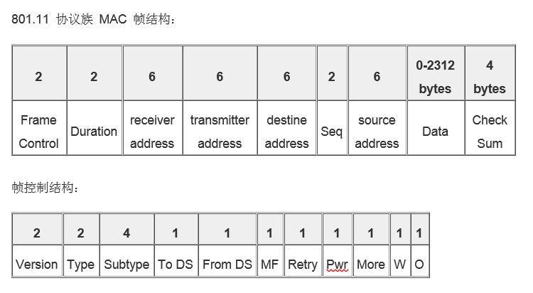
802.11 Frame(2)
The IEEE 802.11 frame format.
WDS（Wireless Distribution System）模式下帧格式

Slide 61
802.11 Frame(3)
Protocol Version ― 表示 IEEE 802.11 标准版本。
Type ― 帧类型：管理、控制和数据。
Subtype ― 帧子类型：认证帧、解除认证帧、连接请求帧，连接响应帧、重新连接请求帧、重新连接响应帧、解除连接帧、信标帧、Probe 帧、Probe 请求帧或 Probe 响应帧。
To DS ― 当帧发送给 Distribution System（DS）时，该值设置为1。
From DS ― 当帧从 Distribution System（DS）处接收到时，该值设置为1。
MF ― More Fragment 表示当有更多分段属于相同帧时该值设置为1。
Retry ― 表示该分段是先前传输分段的重发帧。
Pwr ― Power Management，表示传输帧以后，站所采用的电源管理模式。
More ― More Data，表示有很多帧缓存到站中。
W ― WEP，表示根据WEP（Wired Equivalent Privacy） 算法对帧主体进行加密。
O ― Order 表示利用严格顺序服务类发送帧的顺序。
Duration 值用于网络分配向量（NAV）计算。
RA(receiver address)：无线网络中，该数据帧的接收者
TA(transmitter address)：无线网络中，该数据帧的发送者
DA(destine address)：该帧的目的mac地址
SA(source address)：该帧的源mac地址
Sequence Control ― 由分段号（4位）和序列号（12位）组成。
Data ― 发送或接收的信息。
CRC ― 包括32位的循环冗余校验（CRC）。

Slide 62
Broadband Wireless
802.16 Architecture / Protocol Stack »
802.16 Physical Layer »
802.16 MAC »
802.16 Frames »

Slide 63
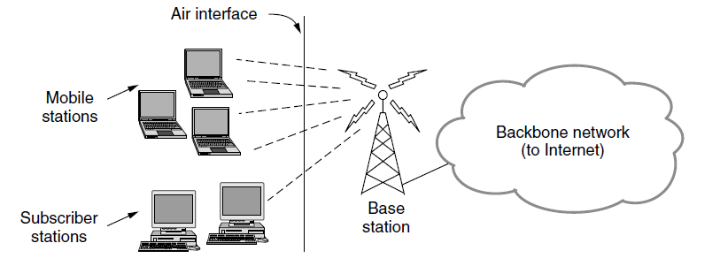
802.16 Architecture/Protocol Stack (1)
Wireless clients connect to a wired basestation (like 3G)

Slide 64
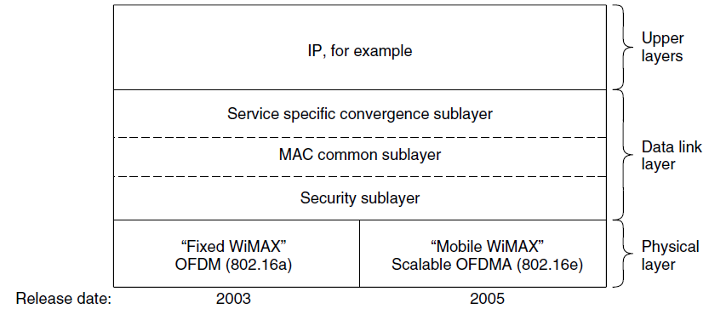
802.16 Architecture/Protocol Stack (2)
MAC is connection-oriented; IP is connectionless
Convergence sublayer maps between the two
WiMAX:全球微波接入互操作性，即802.16
安全子层：处理加密、解密和密钥管理
MAC公共子层—信道管理：基站调度下行信道，管理上行信道。

Slide 65
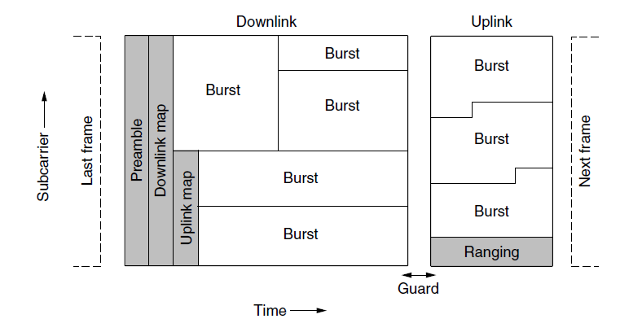
802.16 Physical Layer
Based on OFDM; base station gives mobiles bursts (subcarrier/time frame slots) for uplink and downlink

Slide 66
802.16 MAC
Connection-oriented with base station in control
Clients request the bandwidth they need
Different kinds of service can be requested:
Constant bit rate, e.g., uncompressed voice
Real-time variable bit rate, e.g., video, Web
Non-real-time variable bit rate, e.g., file download
Best-effort for everything else

Slide 67
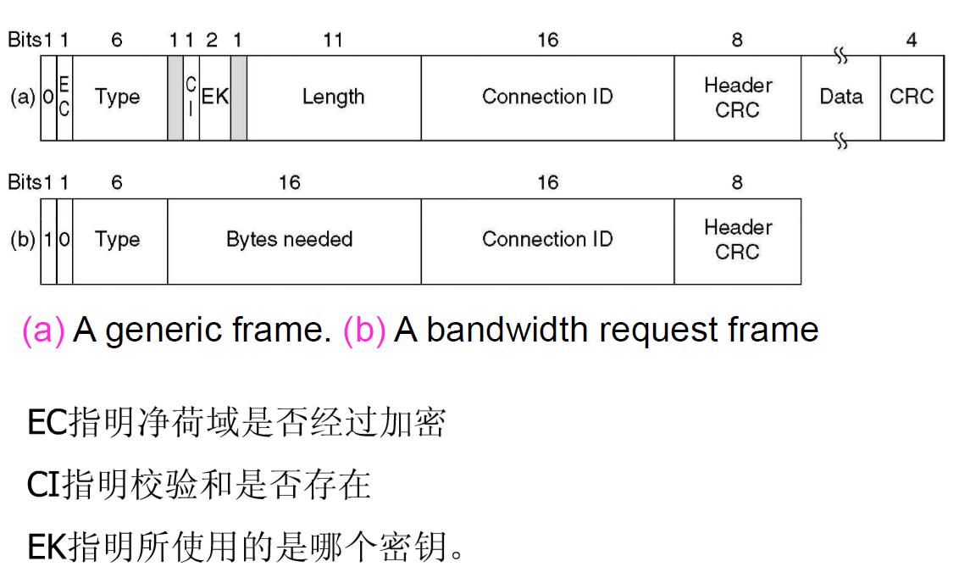
802.16 Frame
Frames vary depending on their type
Connection ID instead of source/dest addresses

Slide 68
IEEE 802.2: Logical Link Control（1）
When a reliable error-controlled flow-controlled data link protocol is required.
Hides differences inherent in the 802.3/4/5/… from the network layer.
(a) Position of LLC. (b) Protocol formats.

Slide 69
IEEE 802.2: Logical Link Control(2)
Three possible options:
Unreliable datagram service.
Acknowledged datagram service.
Reliable connection-oriented service.

Slide 70
Data Link Layer Switching
Bridges from 802.x to 802.y
Local Internetworking
Spanning Tree Bridges
Remote Bridges
Repeaters, Hubs, Bridges, Switches, Routers, Gateways
Virtual LANs

Slide 71
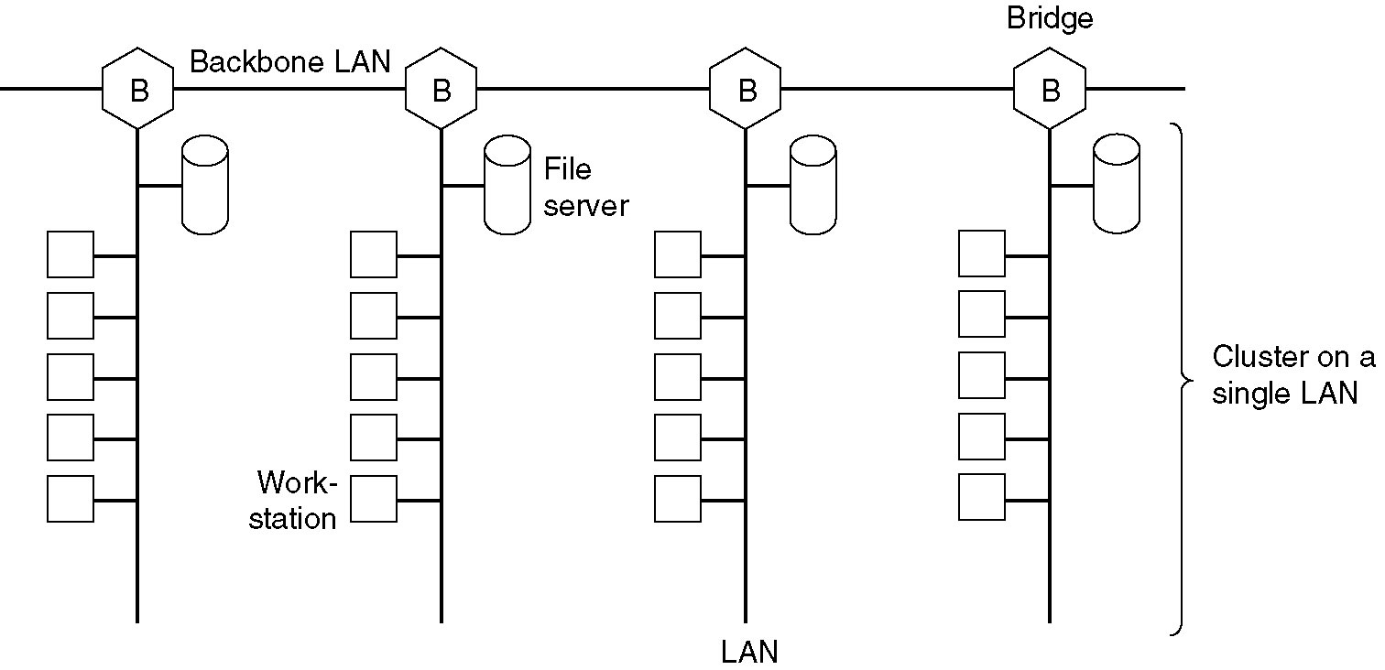
Data Link Layer Switching
Multiple LANs connected by a backbone to handle a total load higher than the capacity of a single LAN.

Slide 72
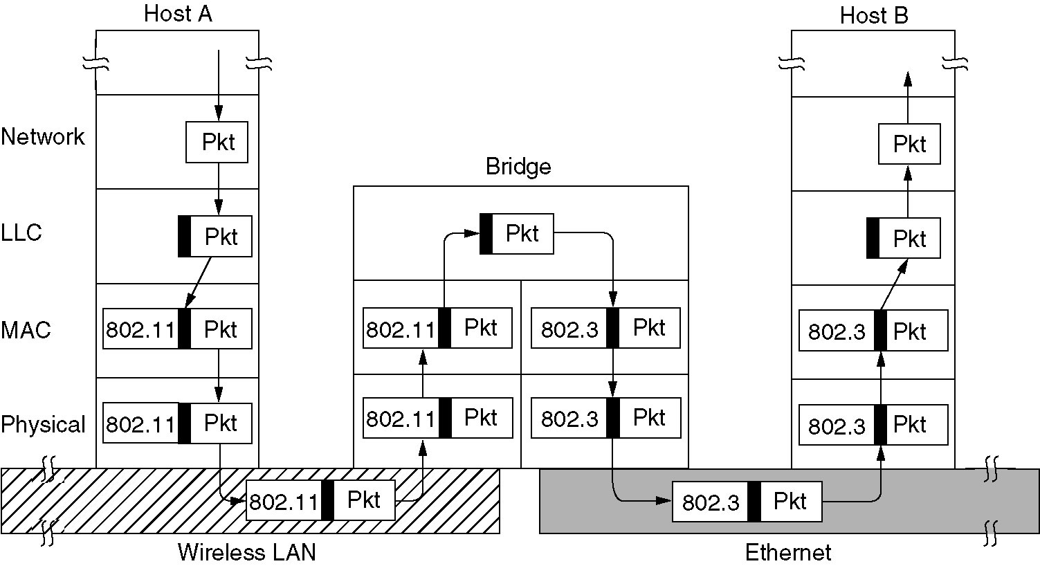
Bridges from 802.x to 802.y
Operation of a LAN bridge from 802.11 to 802.3.

Slide 73
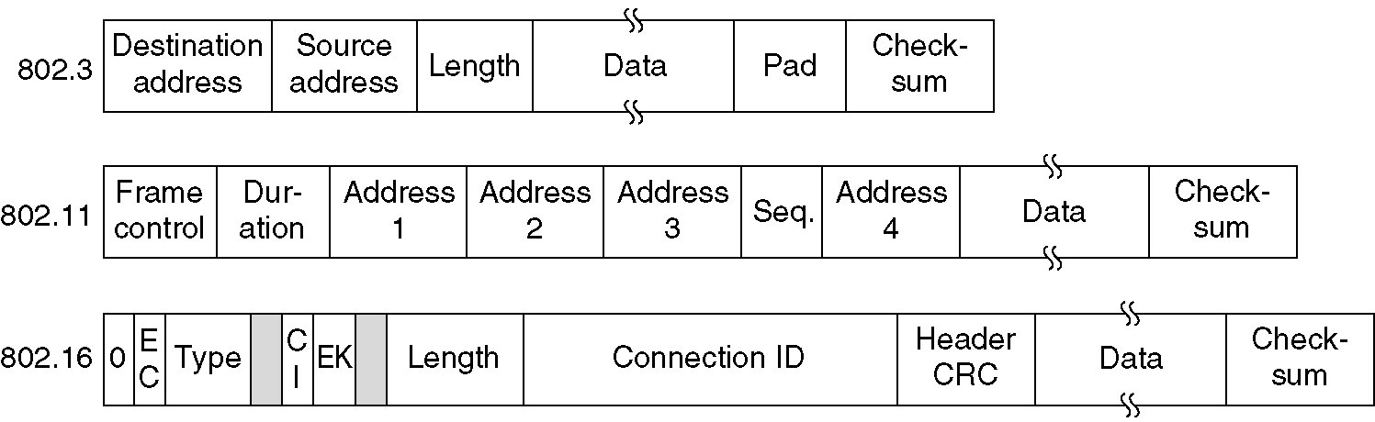
Bridges from 802.x to 802.y (2)
The IEEE 802 frame formats. The drawing is not to scale.

Slide 74
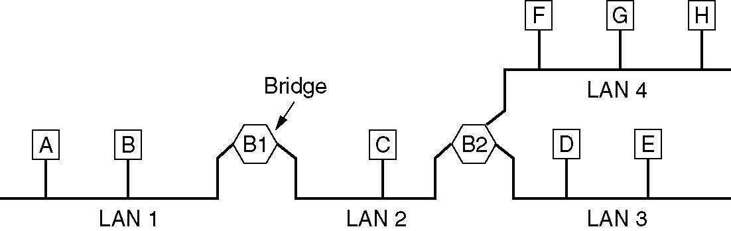
Local Internetworking
A configuration with four LANs and two bridges.

Slide 75
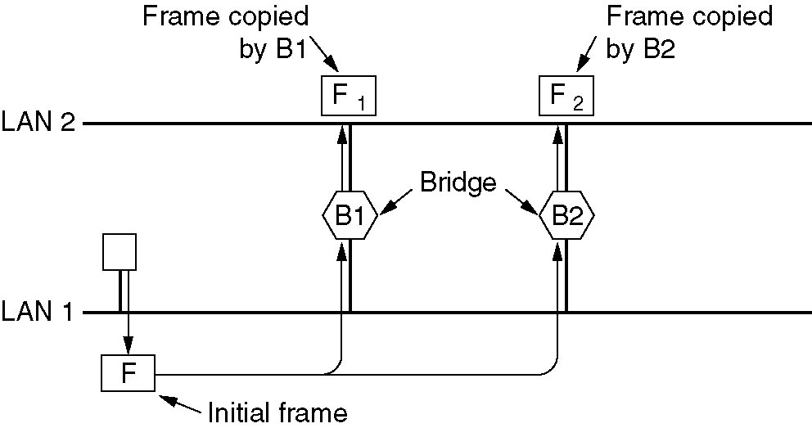
Spanning Tree Bridges（生成树桥）
Two parallel transparent bridges.

Slide 76
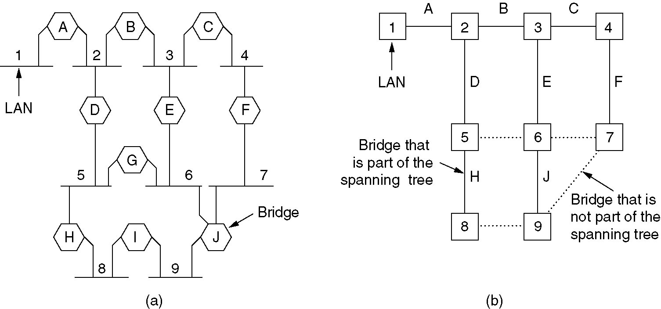
Spanning Tree Bridges (2)
(a) Interconnected LANs. (b) A spanning tree covering the LANs. The dotted lines are not part of the spanning tree.

Slide 77
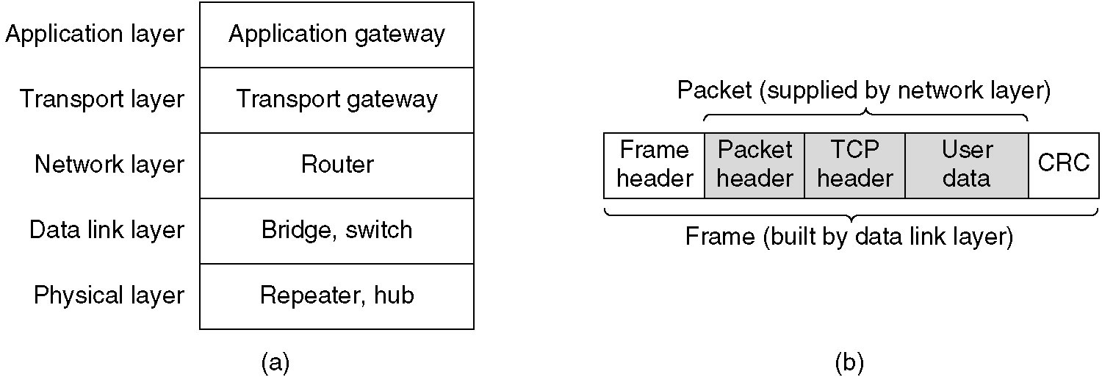
Repeaters, Hubs, Bridges, Switches, Routers and Gateways
(a) Which device is in which layer.
(b) Frames, packets, and headers.

Slide 78
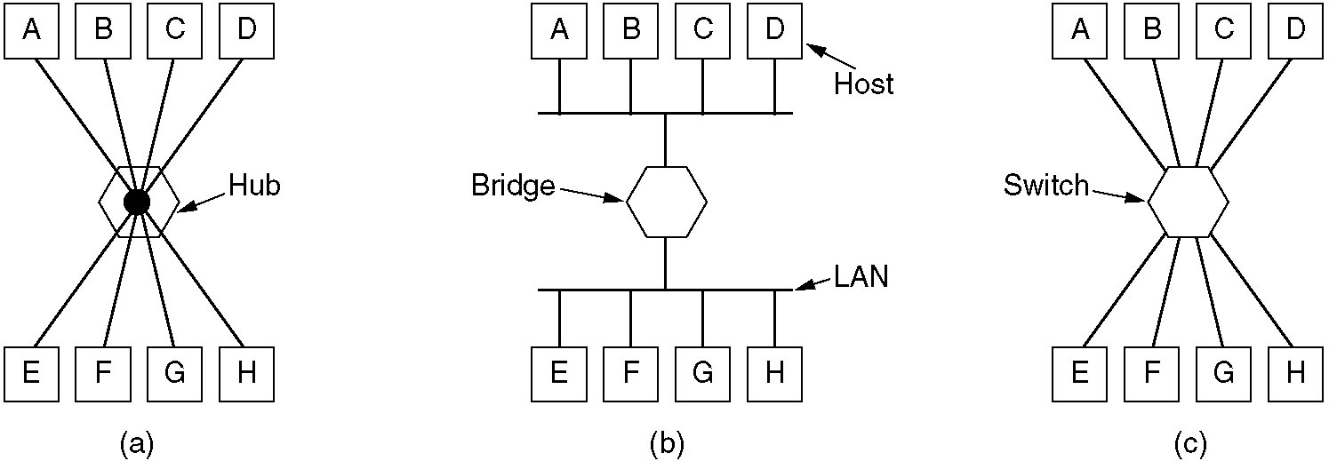
Repeaters, Hubs, Bridges, Switches, Routers and Gateways (2)
(a) A hub. (b) A bridge. (c) a switch.

Slide 79
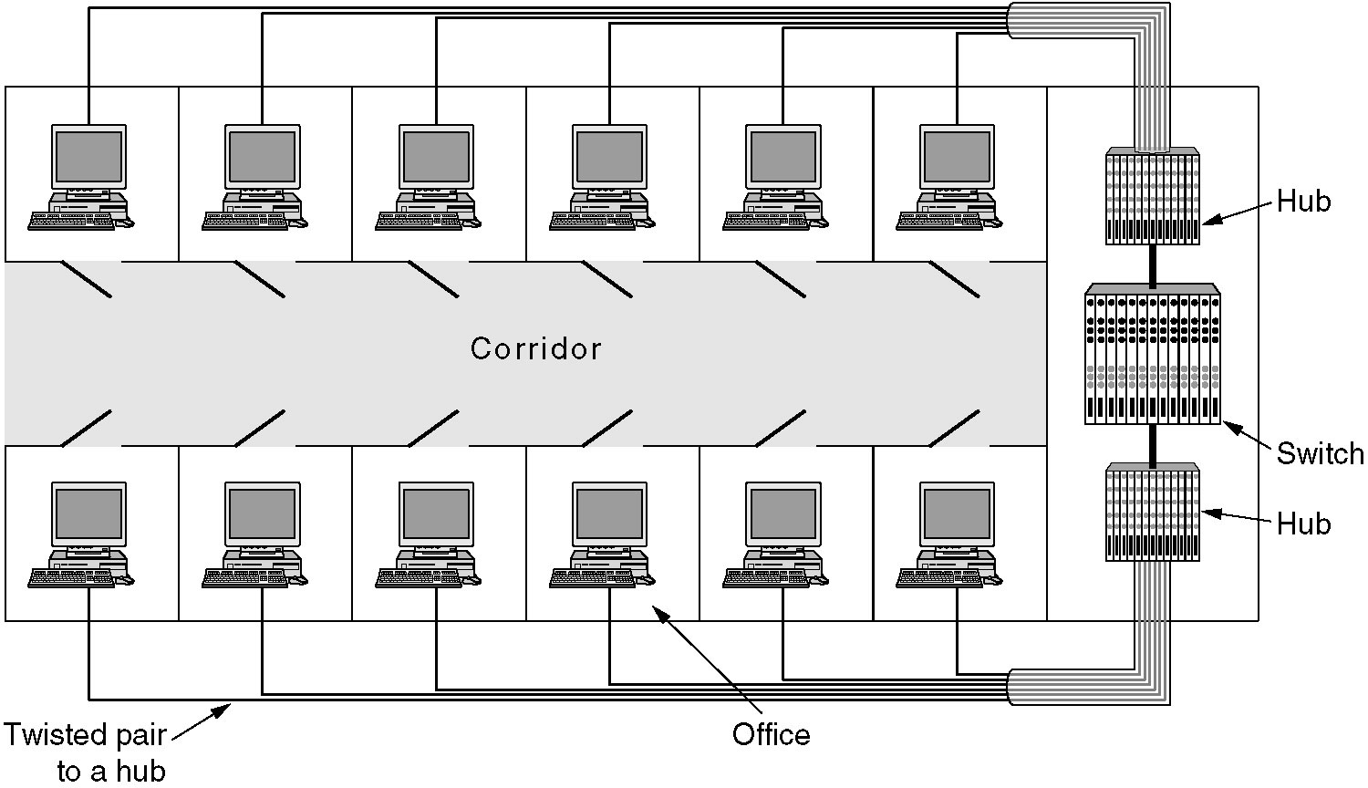
Virtual LANs
A building with centralized wiring using hubs and a switch.

Slide 80
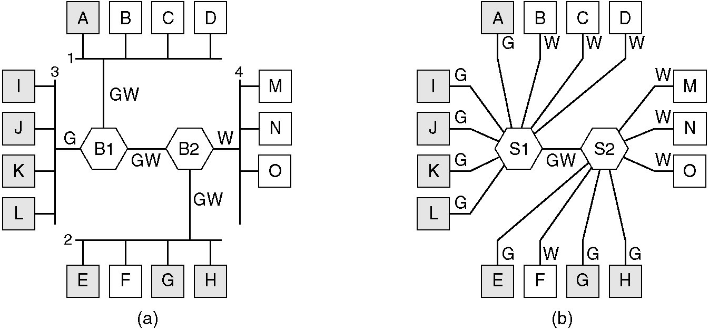
Virtual LANs (2)
(a) Four physical LANs organized into two VLANs, gray and white, by two bridges.
(b) The same 15 machines organized into two VLANs by switches.

Slide 81
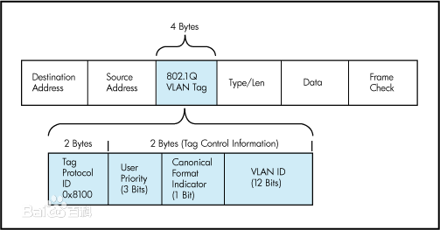
Virtual LANs
Identify the VLAN
Port, all machines on a port belong to the same VLAN
MAC address
Layer 3 protocol or IP address, examine the payload field of the frame
User Priority：定义用户优先级，包括8个优先级别。
CFI：以太网交换机中，规范格式指示器总被设置为0。
VID：VLAN ID 是对 VLAN 的识别字段，该字段为12位。VID=0 用于识别帧优先级。 4095（FFF）作为预留值，所以 VLAN配置的最大可能值为4094。

Slide 82
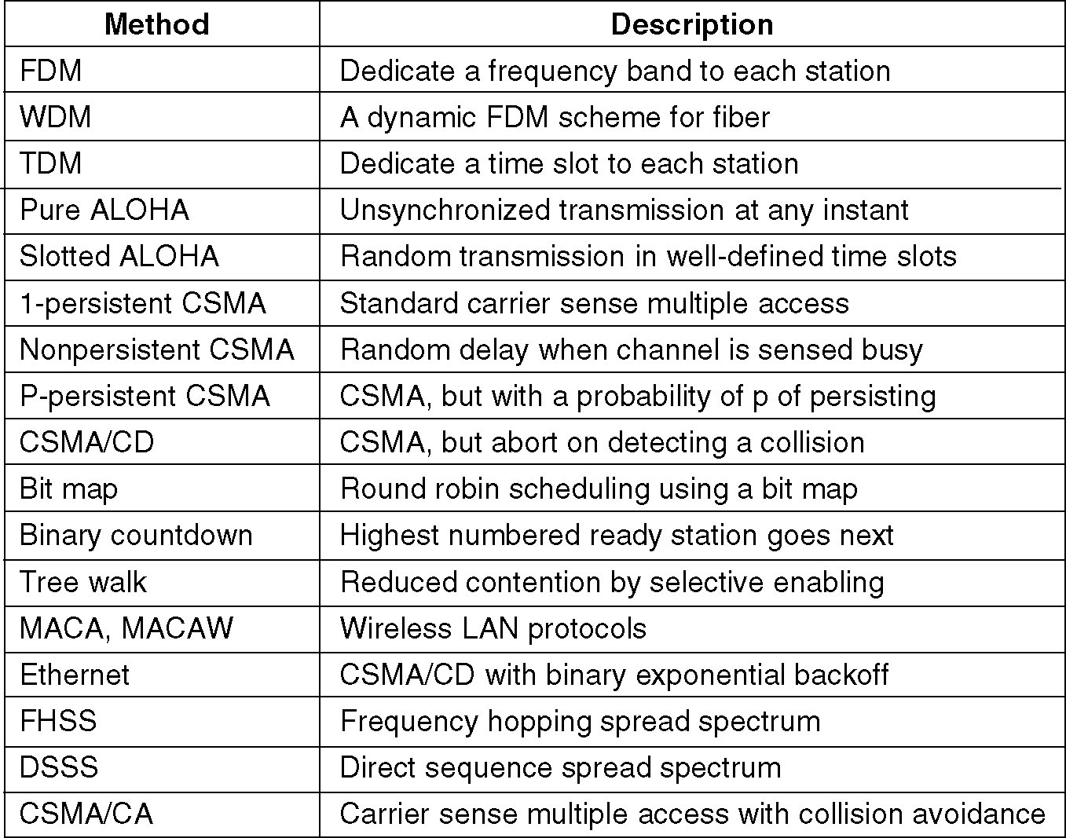
Summary
Channel allocation methods and systems for a common channel.

Slide 83
作业
4.2, 4.4, 4.13，4.14, 4.15，4.16, 4.18, 4.25, 4.36, 4.39

